Slide 1
Building a Roadmap for Research IT
John Brussolo
Research IT Program Director
September 6, 2012
© 2012 The Regents of the University of Michigan

Slide 2
Objectives
Background
Our Challenge
What’s Our Trick?
Project

Slide 3
Background
Reduced Federal Budgets are going to mean that research funding will be harder to obtain in 2013. Academic Medical Centers must do more with less to maintain their level of scientific discovery and innovation. Predictions today are that the NIH could lose up to 11% of its research budget in 2013¹
Meaningful Use has created an mad rush for hospitals and health centers to implement EHR systems. These systems are centered around the episodic nature of patient care data and do not employ the structures necessary to make that data beneficial to research. Many equally expensive techniques will be needed to allow this data to be of any value to the research community
Personalized Medicine is coming to the forefront as more and more treatments are showing effectiveness in partial populations due to molecular biomarkers not surfaced during industry clinical studies. The effort to better understand this compounded with ever decreasing costs for molecular data generation and data storage has created mountains of data contained within many non-integrated silos severely limiting their value to improving science
Shrinking Industry Pipelines are reducing the amount of money industry has to spend on clinical trials while FDA regulations are making it more and more difficult to get product to market. It can take more than a decade to bring a new cancer drug to the market and cost more than $1 billion
¹ Donowitz, M (July 9, 2012). U.S. medical research endangered, The Baltimore Sun

Slide 4
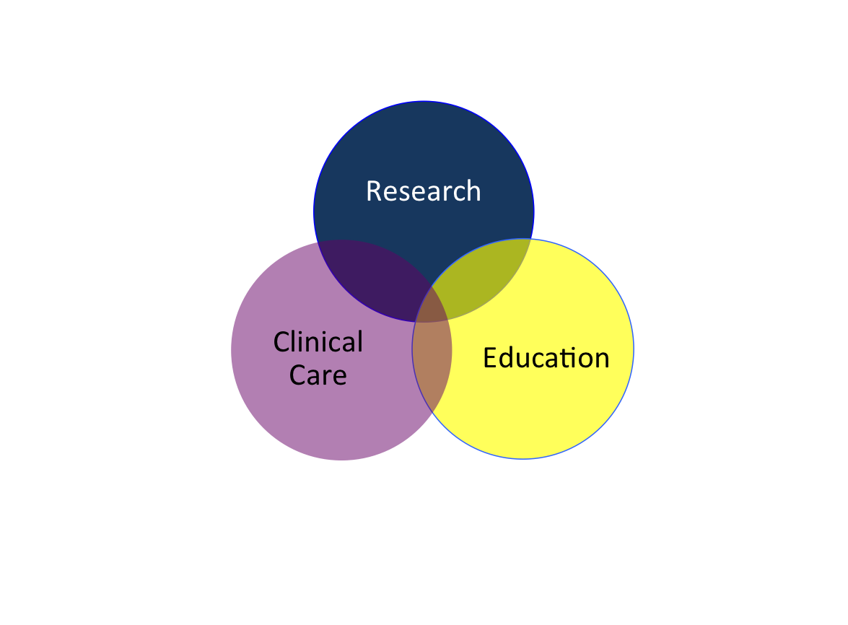
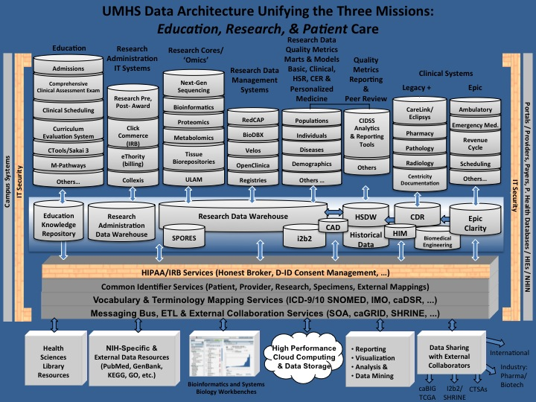
Our Challenge
UMHS Missions
Informatics,
IT & Value
Big Silos
Information Sharing
Complex Data Environment
Protective
Open
Collaboration
Independent
Highly Collaborative
Culture
DO NOT
OPEN
Trust in Centralized Services
DO NOT
OPEN
Low Trust
High Trust and Perceived Value
Entrepreneurialism
Not Empowered
Highly
Entrepreneurial

Slide 5
Position for the Future
To achieve UMHS strategic objectives, research needs to be able to…
Depend on access to UMHS-wide phenotypic and genotypic data that is high-quality and adheres to an agreed upon set of standards
Discover new scientific hypotheses and analytical methods by looking across a comprehensive set of historic patient care and study data
Launch retrospective studies leveraging the full complement of our data and biospecimens
Improve patient care by making quality and outcome research not only more efficient, but by increasing its scope and depth
Support all the above needs in such a way that ensures that UMHS is in full compliance with regulations and laws

Slide 6
Project
The overall goal of the Research Data Strategy and Plan (RDSP) Project is to produce an actionable roadmap to inform research, health system, and IT executive leadership of decisions and systematic steps necessary to transform the research IT platform and related infrastructure and operations.

Slide 7
Project Scope
Reviewed
UMHS Strategic Plan
Previous Research Data Warehouse report
IT Strategic Plan
IT landscape documentation
Interviewed 115+ stakeholders representing
UM
UMHS Leadership
Hospitals and Health Centers
Medical School
Research community
External collaborators

Slide 8
Project Roadmap

Slide 9
Resources

Slide 10
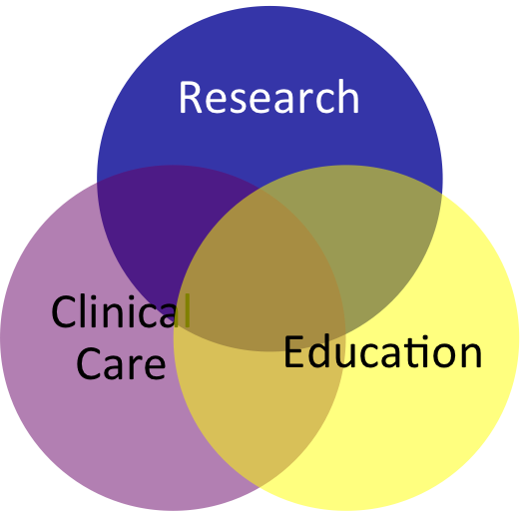
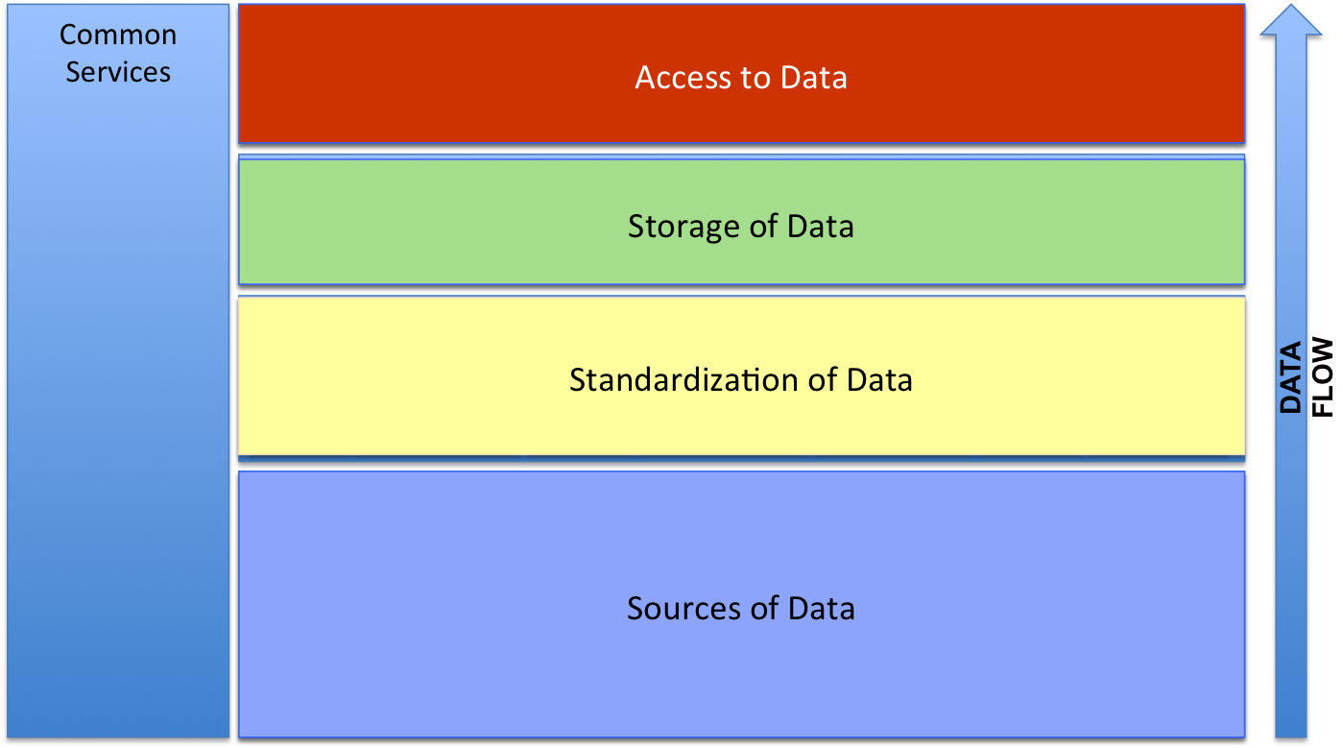
What’s Our Trick?
UMHS Missions
Informatics,
IT & Value
Informatics,
IT & Value
Minimize
Silos
Big Silos
Simplified Data Environment
Research
Information Sharing
Information Sharing
Protective
Protective
Open
Open
Collaboration
Collaboration
Independent
Independent
Highly Collaborative
DO NOT
OPEN
Highly Collaborative
Culture
Culture
Trust in Centralized Services
Trust in Centralized Services
Clinical Care
DO NOT
OPEN
Education
Low Trust
Low Trust
High Trust and Perceived Value
High Trust and Perceived Value
Entrepreneurialism
Entrepreneurialism
Not Empowered
Not Empowered
Highly
Entrepreneurial
Highly
Entrepreneurial

Slide 11
Contact Me:
John Brussolo
Research IT Program Director
734-276-9803
jsbrusso@med.umich.edu

